Slide 1
US Traffic Accident Analysis
By: Joseph Lee
Dataset: US Accidents (2016 – 2023)
Source: https://www.kaggle.com/datasets/sobhanmoosavi/us-accidents

Slide 2
The Business Problem
The US Department of Transportation (DOT) is concerned about the number of traffic accidents across the US and wants to develop strategies to reduce accidents and improve road safety.
Understanding and reducing traffic accidents is a critical mission that directly impacts public safety, economic costs, and quality of life across the United States.

Slide 3
The Different Perspectives
Economic Impact: Traffic accidents cost billions annually in medical expenses, property damage, and lost productivity, making even small reductions highly valuable.
Public Safety: As a leading cause of injury and death, reducing traffic accidents directly fulfills DOT's core mandate to protect citizens.
Infrastructure Prioritization: Data analysis enables strategic allocation of limited infrastructure improvement budgets to highest-risk areas.
Policy Development: Accident data informs new safety regulations and provides metrics to evaluate existing programs' effectiveness.
Stakeholder Accountability: Comprehensive analysis demonstrates evidence-based decision-making to Congress, local governments, and the public.
Cross-Agency Collaboration: Shared data insights can align accident reduction efforts across DOT, law enforcement, and emergency services.
Technology Integration: Understanding accident patterns guides how emerging vehicle technologies should be regulated to maximize safety benefits.

Slide 4
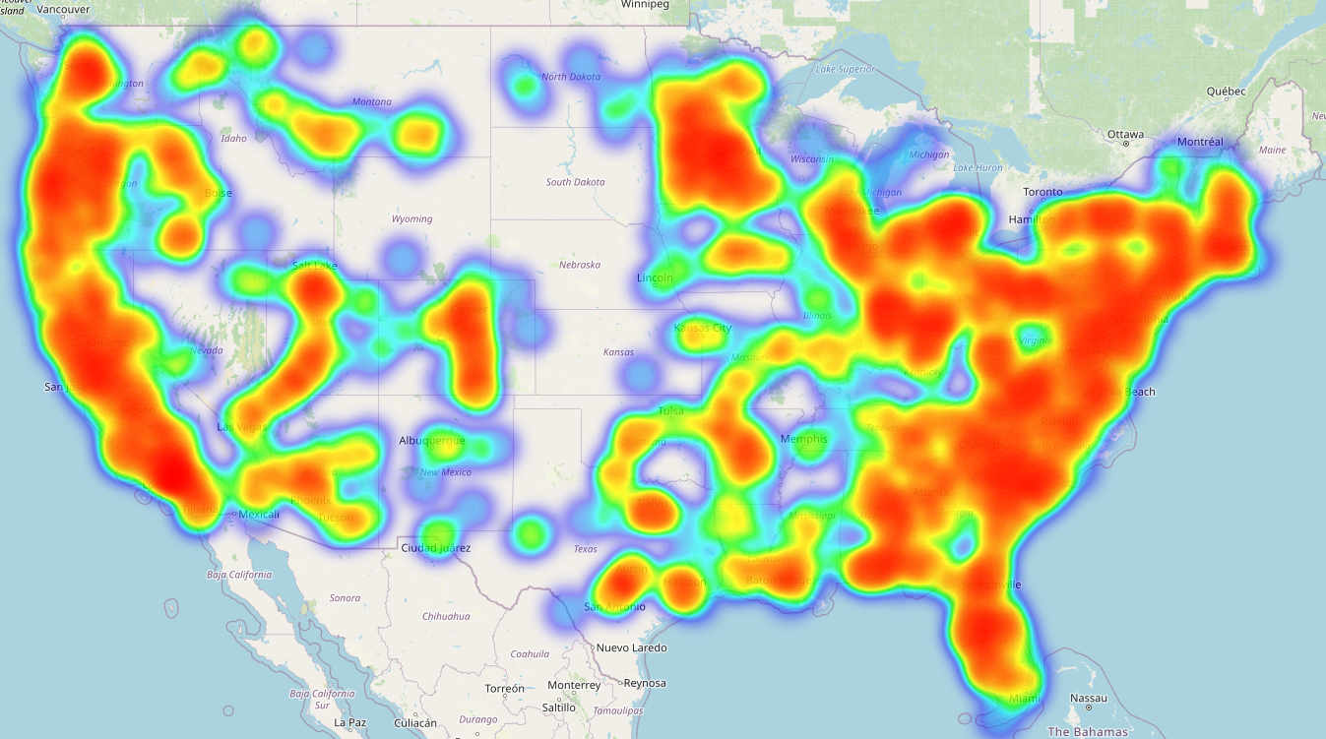
Data Overview
Scope: 49 contiguous states of the USA
Timeline: February 2016 to March 2023
Number of observations (accidents): 7.7 million
Data contains:
Accident severity level
Time
Geography
Weather
Presence of infrastructure

Slide 5
Analysis: Understanding the Data
The data contains 7.7 million accidents with up to 46 features per accident
Features include what time the accident occurred, location (city, county, state, zipcode), the weather (temperature, wind chill, humidity, pressure, visibility, wind speed, precipitation), and presence of infrastructure (speed bumps, pedestrian crossings, junctions, railways, roundabout, stations, stop signs, traffic signals, and turn loops)
Accidents with missing geographical data such as city and zipcode were discarded since they were a tiny portion of the overall data
Accidents with missing weather data were filled in with the associated median so as to not lose all of the valuable data that is still present
Missing precipitation was assumed to be no rain

Slide 6
Analysis: Preparing the data
Time data was converted to group times into time of day categories, to group times into the seasons of the year, to search for accidents occurring on holidays
Weather data with extreme outliers that didn’t make sense or realistic in the US were dropped
Infrastructure data was complete so no preparation was required

Slide 7
Analysis: Exploratory Data Analysis
Exploratory data analysis found that most accidents are classified as Moderate (level 2), followed by High (level 3), then severe (level 4), and Low (level 1)
Most accidents occur in the states of California, Florida, and Texas
In the counties of Los Angeles, Miami-Dade, Harris, Dallas and Mecklenburg
In the cities of Miami, Houston, Los Angeles, Charlotte, and Dallas

Slide 8
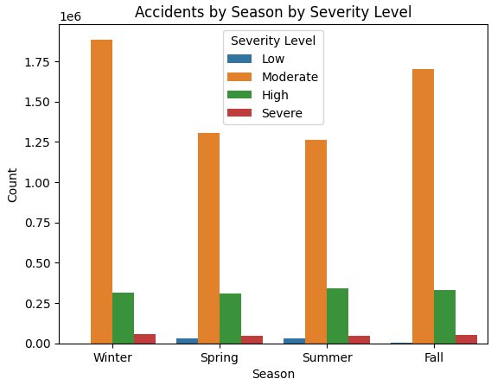
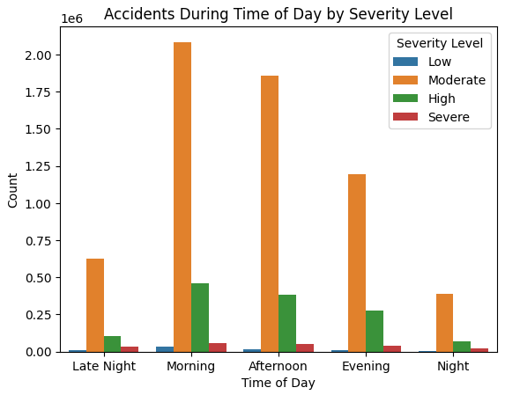
Analysis: Exploratory Data Analysis
Most accidents occur in winter and fall, and during the morning and afternoon

Slide 9
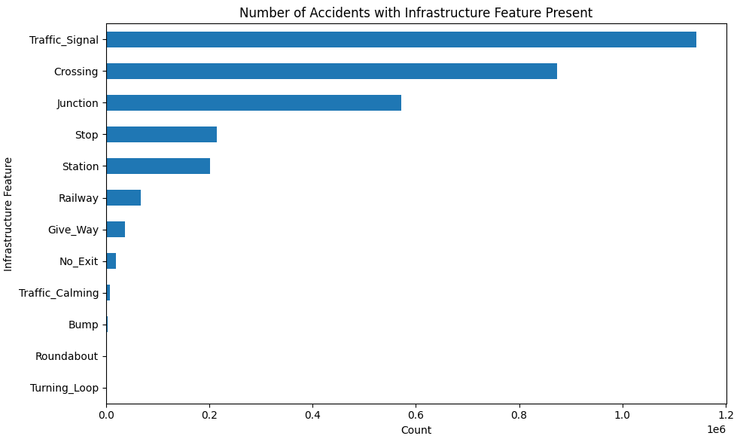
Analysis: Exploratory Data Analysis
Most accidents occur at traffic signals, pedestrian crossings, junctions and stop signs

Slide 10
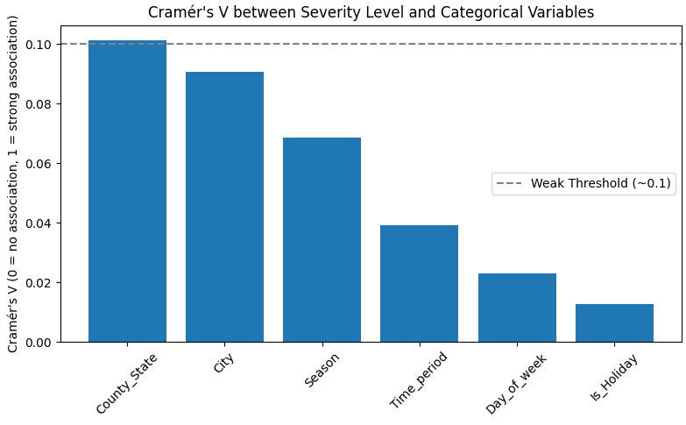
Analysis: Statistical Data Analysis
Chi squared test concluded that accident severity level is significantly associated with city, county, time of day, and others
Cramer’s V concluded that city, county, day of week, season and time of day have the most effect on accident severity level

Slide 11
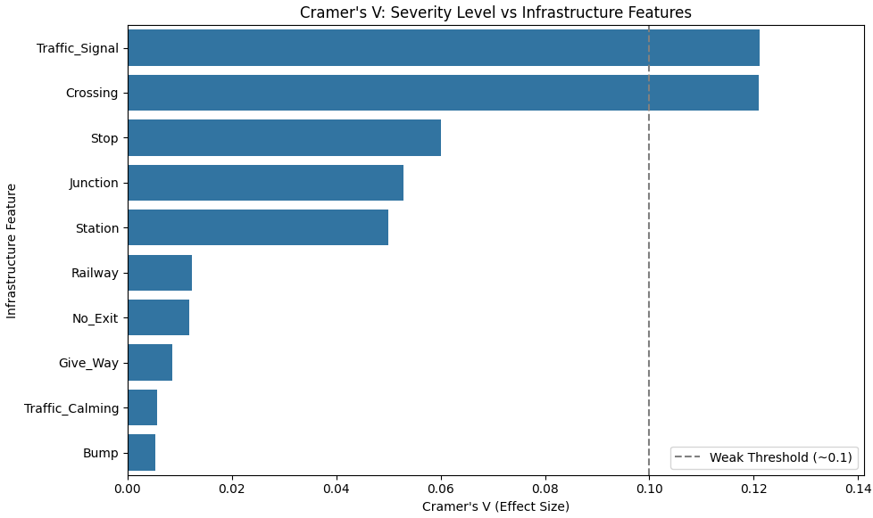
Analysis: Statistical Data Analysis
Chi squared test concluded infrastructure is statistically associated with accident severity level
Cramer’s V concluded that traffic signals, pedestrian crossings, stop signs and junctions have the greatest effect on accident severity level

Slide 12
Results: Recommendation 1
It is recommended that DOT look to high density urban counties such as Los Angeles and Miami-Dade to alleviate traffic during rush hour in the mornings and evening when commuters are trying to get to and from work. Available resources should be put into targeted infrastructure investment to ensure traffic can flow as much as possible. That could be ensuring that highways are properly maintained and widened at key corridors, ensuring lighting is sufficient for visibility in the early morning and evening, and optimizing traffic signal timing to reduce congestion at major intersections. There could be systems deployed to dynamically adjust signals based on real time traffic volumes. There improvements could help reduce accident frequency and improve safety in major cities and counties.
The potential impact could be reduction in accident rates and injuries.
Effectiveness could be measured by 10% reduction in accident rates and severity levels which would indicate success.

Slide 13
Results: Recommendation 2
It is recommended that DOT put special emphasis on its efforts to reducing accidents during the fall and winter when there is more inclement weather. Adverse weather during those seasons with low temperatures and windchill, and high humidity could lead to slippery roads and reduced visiblity that make it difficult for drivers to navigate to their destination. Resources should be put into early weather alert systems, proactive road and highway salting and deicing operations, real-time hazard notifications for drivers and seasonal education campaigns to remind drivers to adjust their driving behavior appropriately. These interventions could help drive down accident rates and improve public safety during the most dangerous seasons.
The potential impact could be a decrease in accident volume and improvement to public safety during the most dangerous seasons of the year.
Effectiveness could be measured by a 10% reduction in accident rates and severity during those winter and fall months year over year.

Slide 14
Results: Recommendation 3
The DOT should invest in educational campaigns on TV, social media, apps, on the street to promote safety around areas of convergence such as traffic signals, pedestrian crossings, stop signs and junctions. These areas are associated with increase in accidents, many that are serious, possibly due to car and pedestrian interaction. It can also put resources into early warning signs, putting high visibility markings on road surfaces to provide early indication to drivers that an intersection is near and coming up soon. These efforts can help improve driver awareness and reduce accident severity and occurrence at these critical decision points.
The potential impact could be a decrease in accident rates and the severity of those accidents.
Effectiveness could be measured by a 10% decrease in accidents near these junctions and the severity level of those accidents.

Slide 15
Conclusion
This analysis examined traffic accident trends across cities/counties, time of day, seasons, weather, and infrastructure to inform potential safety improvements.
Objective 1 - Morning and afternoon had the highest accident volumes. High density counties like LA and Miami-Dade had the most accidents.
Objective 2 - Winter and fall had the most accidents. Temperature and windchill were significantly different between severity levels(confirmed by Welch's ANOVA and Dunn's posthoc test)
Objective 3 - Accidents are more likely to occur at places with traffic signals and crossings. Traffic signals showed the strongest assocation with severity (cramer's V = 0.12)
The Cramer's V scores suggest that accident severity is not random across cities or infrastructure. Although Cramer's V scores are not significant, when applied to a dataset of this scale, even small improvements will have meaningful impact overall.
Next steps would be to explore real time weather feeds to build predictive risk models and incorporate driver demographics where possible.

